Slide 1

Unit 22: People in computing

Slide 2

People in computing
1 Webmaster – a person who administers a Web server
2 Help-desk troubleshooter - a telephone service for helping users solve problems that occur on computer systems
3 Applications programmer - a person who writes applications programs using a computer language
4 Security specialist - detects, prevents and resloves security threats
5 Systems programmer - a person who specialises in writing systems software such as operating system programs

Slide 3
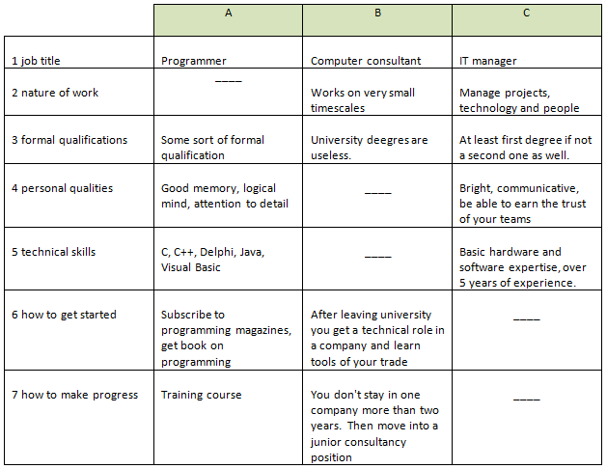
People in computing

Slide 4
People in computing
Manageable – that can be controlled
Sole – only, single
Merely – simply or only
Timescale – the span of time within which certain events occur

Slide 5
Becoming certified
Marketability – marketable – wanted by the public and therefore able to be sold
Array – things, people etc. arranged in some order
Myriad – a very great number of persons or things
Requisite – required or neccessary for a particulare purpose, position etc.
Allot – to give a fixed share of or place

